Slide 1
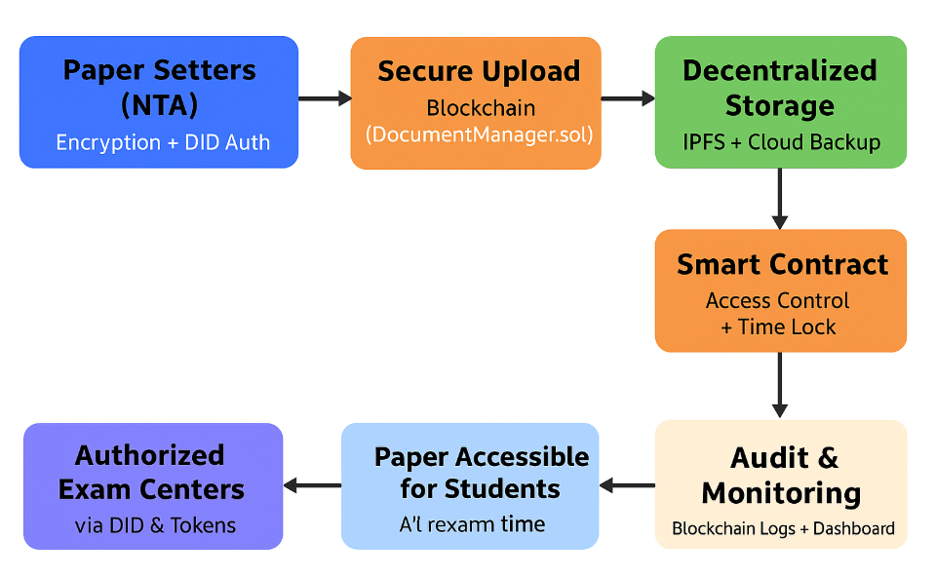
Lokhub
-Next-Gen Digital Locker
Bringing trust , transparency and security to Indian records. “ Secure , Decentralized, future-ready”
Blockchain and cloud powered Digital locker Ecosystem
India’s First Ever Platform Dedicated to Securing Exam Papers leaks & Sensitive Documents

Slide 2
Introducing LokHub
Every year, India faces repeated cases of exam paper leaks, fake certificates, and tampered documents. These incidents destroy the dreams of students and shake the trust in institutions and governance.
LokHub is designed to solve this. It is India’s first blockchain and cloud-powered digital locker built especially to keep exam papers and sensitive documents tamper-proof, secure, and accessible only to the right people at the right time.
Here’s how it works:
1. Documents are given a digital seal on blockchain that cannot be erased or changed.
2. Files are stored in decentralized storage (IPFS + Cloud), preventing hacks and leaks.
3. Smart contracts control access automatically, removing middlemen.
4. Digital tokens act like secure keys for students, teachers, and officials.
Unlike existing systems, LokHub is trustless and insider-proof. It closes the very loopholes that allow exam leaks and document fraud today.
In simple words:
*Students get fair exams
*Citizens get secure identity
*Institutions get reliable records
LokHub is not just a project — it is a step towards restoring trust in India’s digital future.

Slide 3
Why India Needs LokHub Now
In recent years, India has witnessed a disturbing rise in exam paper leaks and document fraud. From competitive exams like UPSC, SSC, and NEET to state-level recruitment tests, a single leak has ruined the dreams of lakhs of students. Families lose trust, genuine efforts go waste, and institutions face massive reputational damage.
The problem doesn’t stop at exams. Fake certificates, tampered land records, and forged identity documents are becoming common. Most of these issues happen because today’s systems are centralized — meaning all power lies with a few insiders such as printing press staff, administrators, or server managers. Just one mistake, or one corrupt insider, can bring down the whole system.
The cost of these leaks is huge:
For students: Years of preparation lost in a single night.
For institutions: Financial loss, loss of credibility, and re-conducting exams at massive expense.
For governance: Erosion of trust in the education and administrative system.
This is where LokHub becomes essential. By using blockchain, decentralized storage, and smart contracts, it eliminates insider risks and makes documents tamper-proof and leak-proof. No single authority can manipulate the system, and every transaction is recorded transparently.
In a country where youth are the backbone and fair opportunities matter the most, LokHub is not just a solution — it is a necessity.

Slide 4
How LokHub Works Behind the Scenes(Technology)
LokHub is built using a combination of advanced but easy-to-use technologies, each solving a specific problem of leaks, tampering, and insider risks.
1. Blockchain
Think of it like a digital notebook shared by everyone. Once something is written, it cannot be erased or changed. In LokHub, exam papers and documents get a tamper-proof seal, so no one can secretly edit or leak them.
2. Smart Contracts
These are self-executing rules stored on blockchain. For example: “Exam paper opens only at 9:00 AM.” No official or insider can change this rule — it is automatic and transparent.
3. Decentralized Identity (DID)
Instead of depending on one server or authority for login, every user gets a unique blockchain-based ID that they control. This means only the rightful student, teacher, or official can access their documents — privacy is protected.
4. Cloud Computing (Infura)
For large-scale exams and records, LokHub uses cloud integration so that data is fast, scalable, and available anytime. It works smoothly even if lakhs of users log in at once.

Slide 5
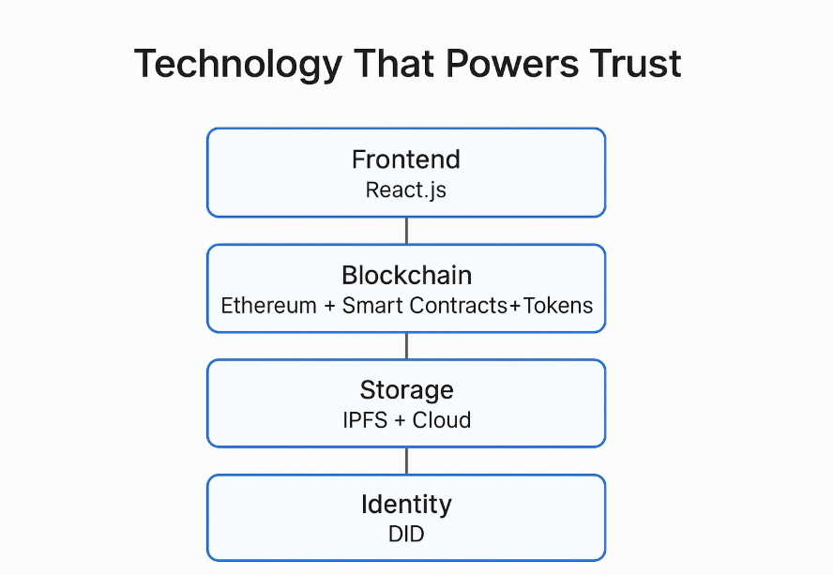
5. IPFS (InterPlanetary File System)
Instead of storing files in one server, IPFS breaks them into small pieces stored across many computers. Even if one server is hacked or fails, the document is still safe. This makes storage decentralized and unbreakable.
6. Token Layer (ERC-20)
Tokens act like digital keys. A teacher might have a “create key,” a student has a “view key,” and an admin has a “manage key.” This ensures role-based, controlled access without manual approvals.
7. React.js Dashboard
All this advanced technology is wrapped in a simple,
user-friendly website where users can upload, check,
and manage their documents easily.
It makes a highly technical system look simple for everyone.
Together, these technologies make LokHub:
Decentralized: No single point of failure.
Tamper-proof: Impossible to secretly edit or leak.
Automated: Rules are enforced without human interference.
User-friendly: Anyone can use it, even without technical knowledge.

Slide 6
Security & Uniqueness
1. End-to-End Encryption: All documents and data are encrypted before storage using advanced cryptographic algorithms, ensuring that only authorized users can access them.
2. Blockchain-Based Integrity: Every action—upload, share, or access—is recorded on the blockchain, making tampering or unauthorized changes impossible.
3. Decentralized Storage: Documents are stored on IPFS and cloud backups, removing a single point of failure and preventing data loss.
4. Tokenized Access Control: Users are assigned unique ERC-20 tokens for access,ensuring only verified individuals can view or modify documents.
5. Unique Digital Identity (DID): Every user has a decentralized identity, making impersonation or fraudulent access nearly impossible.
6. Audit Trails and Transparency: Complete, immutable logs of every activity,
allow instant verification of who accessed what and when.
7. Versatility Across Exam Types: Applicable for online and offline exams,
LokHub ensures security from paper printing to submission, preventing leaks or insider threats.
Key Uniqueness: LokHub combines blockchain, decentralized storage, tokenization, and DID in a single platform—a solution unmatched by traditional systems.

Slide 7
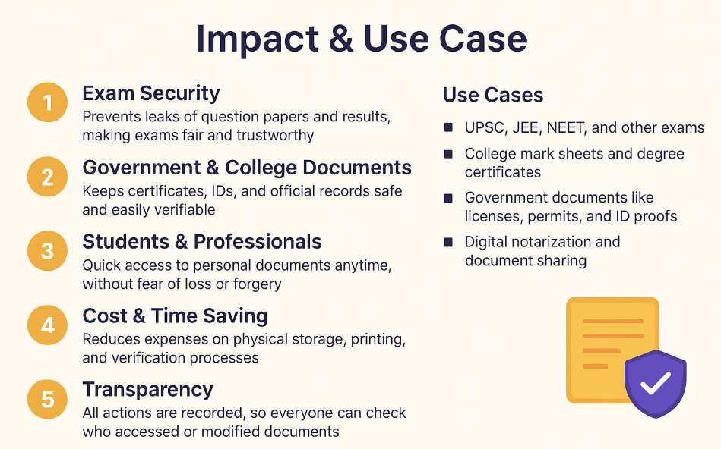
Impact & Use Case
1. Exam Security: Prevents leaks of question papers and results, making exams fair and trustworthy.
2. Government & College Documents: Keeps certificates, IDs, and official records safe and easily verifiable.
3. Students & Professionals: Quick access to personal documents anytime, without fear of loss
or forgery.
4. Cost & Time Saving: Reduces expenses on physical storage, printing, and verification processes.
5. Transparency: All actions are recorded, so everyone can check who accessed
or modified documents.
6. Use Cases:
UPSC, JEE, NEET, and other exams
College mark sheets and degree certificates
Government documents like licenses, permits, and ID proofs
Digital notarization and document sharing
Key Impact: LokHub creates a safer, faster, and more reliable system for managing
and verifying documents—making life easier for students, institutions,
and governments.

Slide 8
Budget Required
1. Non-Recurring Funds – ₹5,00,000
Frontend & UI/UX → ₹1,50,000
Backend & Smart Contracts → ₹1,50,000
Storage (IPFS + Cloud) → ₹80,000
Security & DID → ₹70,000
Testing & QA → ₹50,000
2. Recurring Funds – ₹2,00,000
Cloud Hosting → ₹1,00,000/year
Maintenance & Updates → ₹50,000/year
Misc. Operational Costs → ₹50,000/year
3. Travel – ₹30,000
Workshops, meetings, hackathons
4. Miscellaneous – ₹20,000
Contingency for extra tools/expenses
Expenditure heads | Cost(INR)
Recurring funds | 200000
Non-Recurring funds | 500000
For Travel | 30000
Miscellaneous | 20000
Total | 750000

Slide 9
Future Scope & Industry Applications
Education & Exams
Secure online/offline exams, question paper distribution, result verification.
AI-assisted proctoring and analytics for student performance.
Government & Public Sector
Safe storage and verification of certificates, licenses, and official documents.
Blockchain-based citizen ID and e-governance services.
Corporate & HR
Employee document management, contracts, and compliance verification.
Tokenized access for sensitive internal files.
Healthcare
Secure management of medical records and prescriptions.
Patient-controlled access to personal health data.
Legal & Finance
Smart contracts for agreements, notarization, and audit trails.
Fraud-proof storage of sensitive financial and legal documents.
Future Tech Enhancements
AI-powered analytics for data insights.
Mobile apps for easy access anywhere.
Scalable to integrate IoT, DeFi, or NFT-based document verification.

